Slide 1
Sellswords and Spellcrafts
Luke Schnetlage
Mason Evans
Nicolas Towery

Slide 2
Content
Changes and Deviations
Accomplishments
To-Do List
Conclusion

Slide 3
Changes/Deviations
Project development and management has shifted from Visual Studio Code to Replit.
Allows for working in tandem through Team Repls.
Allows for direct connection to git repository.
Allows easy access to authentication

Slide 4
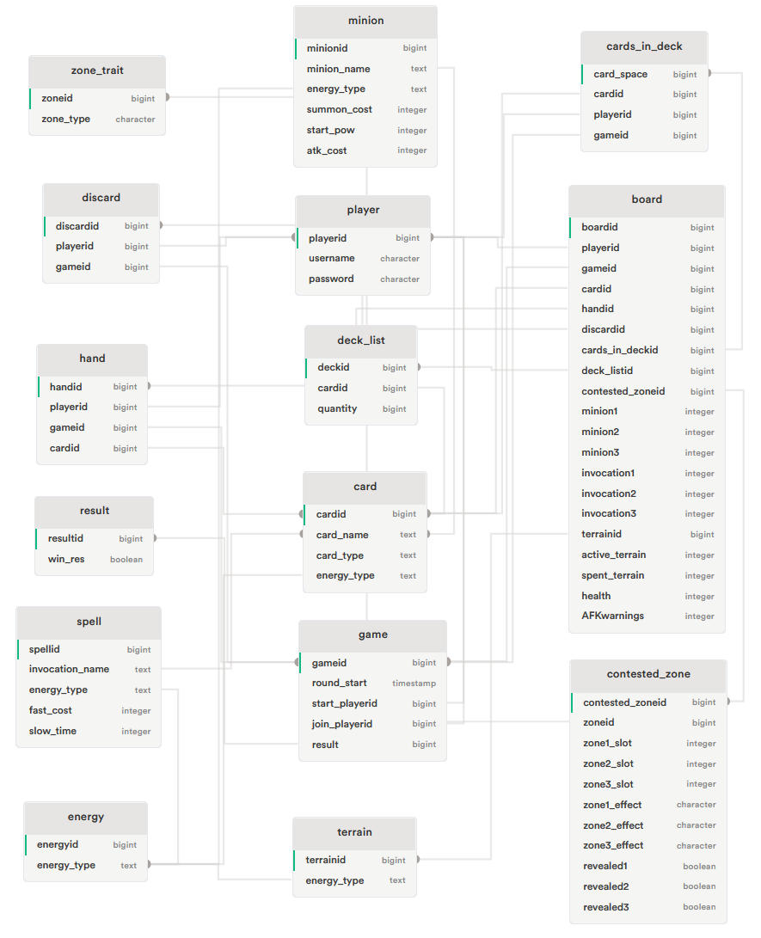
Changes/Deviations
Switching from PHPMyAdmin through iFastNet to Supabase
Done in PostgreSQL instead of MySQL

Slide 5
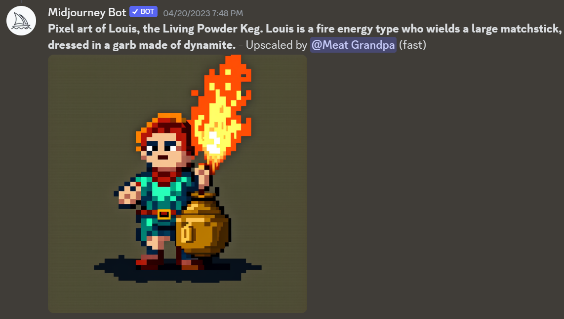
Changes/Deviations
The way game-based art is designed has been altered
From handmade pixel art to Midjourney created art.

Slide 6
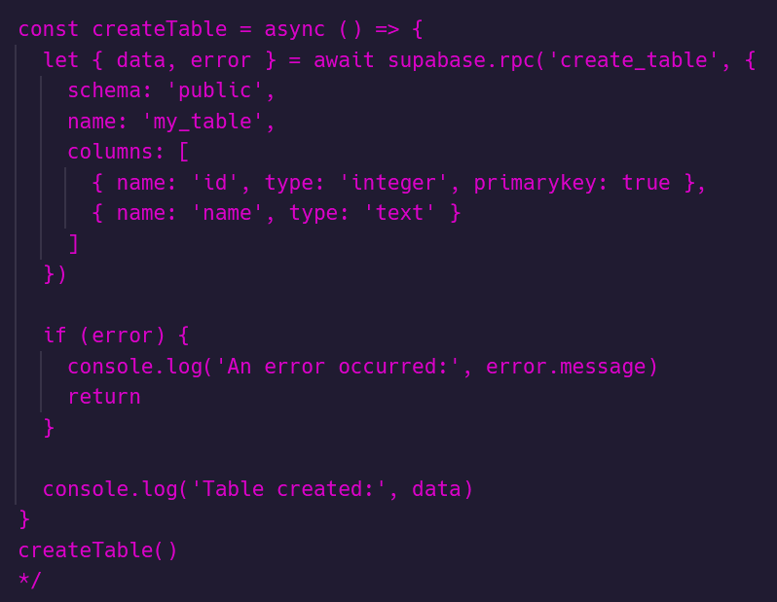
Accomplishments
Successful implementation of new Supabase database.
Can be accessed through Supabase library using JavaScript

Slide 7
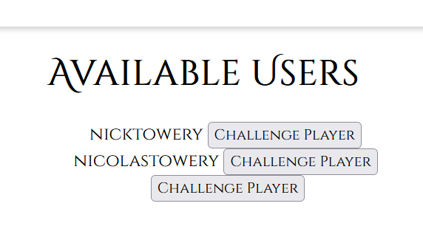
Accomplishments
User able to challenge each other through socket connections
After challenging, users able to select deck prior to beginning the gameplay.

Slide 8
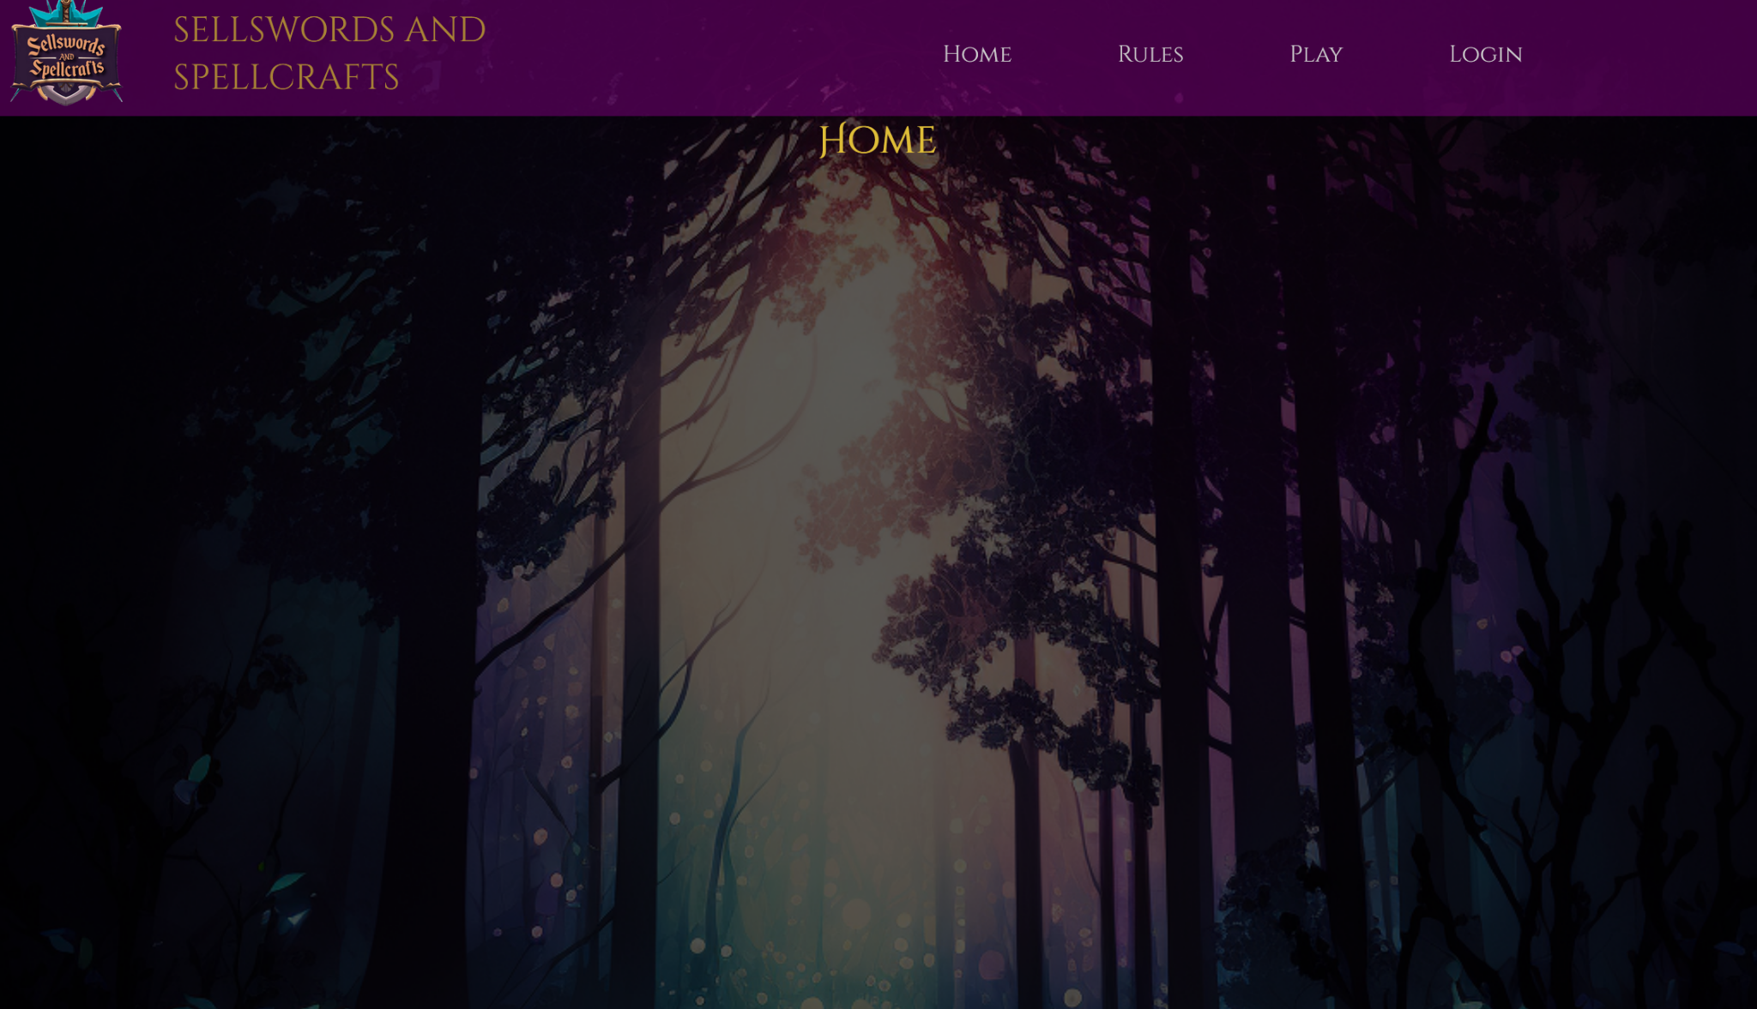
Accomplishments
Implemented a responsive interface in React
Allows for smooth transition from desktop to mobile
Background art for website was designed in Midjourney

Slide 9
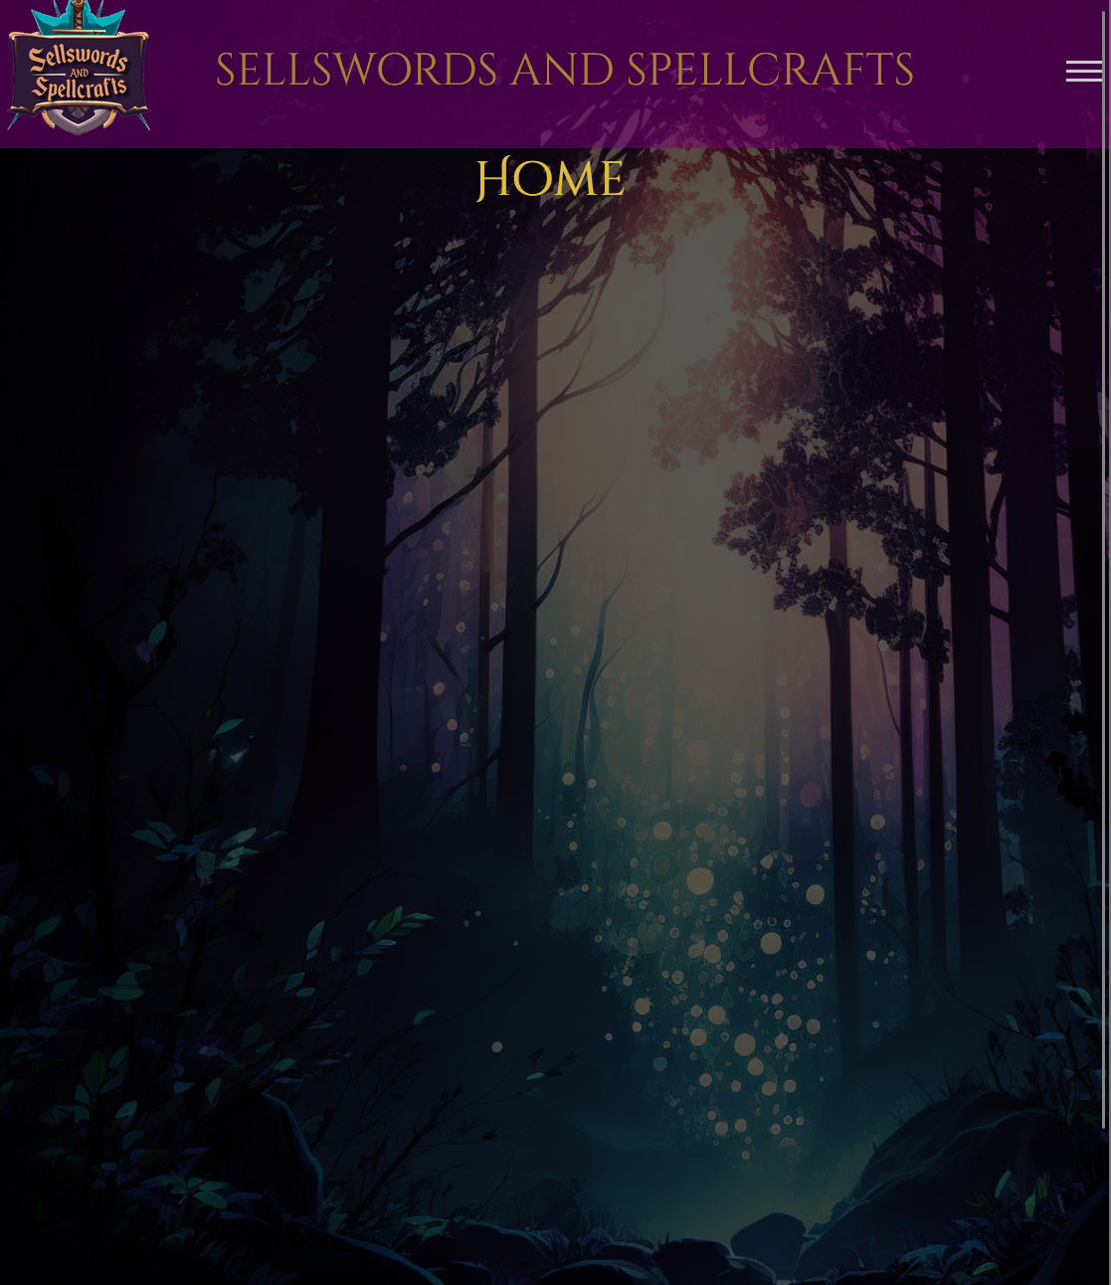
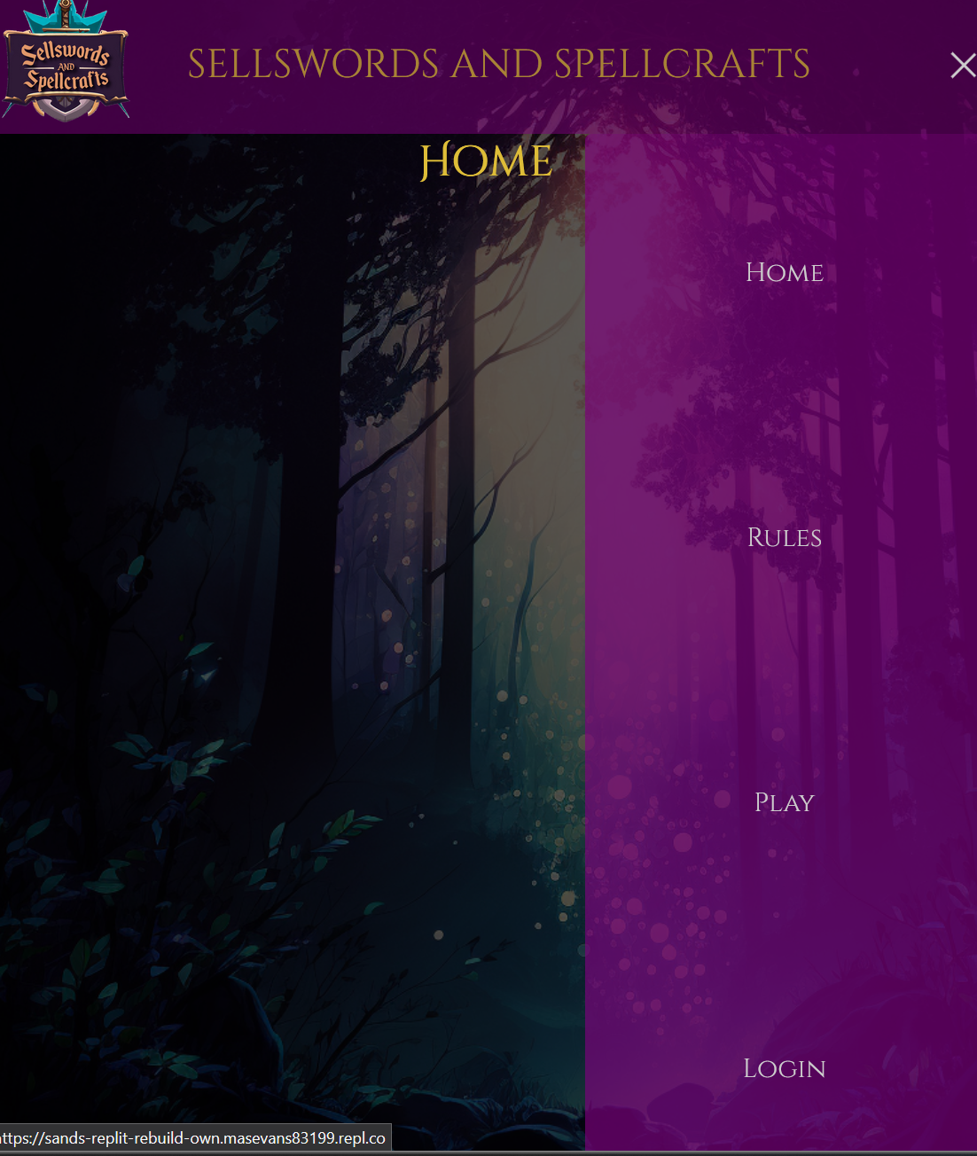
Accomplishments

Slide 10
To-Do List
Finish implementing game logic
Game art design
Custom login page through Replit’s authentication service

Slide 11
Issues to Resolve
Large number of users connecting to server
Deck selection issues
Only able to select one deck at the moment

Slide 12
Conclusion
Numerous changes to the project as a whole.
Despite major roadblocks, substantial progress has been made.
Once issues are resolved for this version, begin version 2.0 of Sellswords and Spellcrafts.

Slide 13
For Reference
Replit Documentation:
https://docs.replit.com/
Supabase Documentation:
https://supabase.com/docs
Midjourney Documentation:
https://docs.midjourney.com/

Slide 14
Thank You

